Slide 1



Myth
You need a degree to work in science.
True or false? Decide before we move on.
Science · 1 / 5
Notes:
Read the myth aloud. Ask students to vote true or false. Don't reveal the answer yet. Time: 25–40 minutes total.

Slide 2

Truth
Many science careers start with an apprenticeship or college course.
Laboratory technician apprenticeships
Veterinary nursing via apprenticeship or college
Wind turbine and renewable energy technicians
Healthcare support roles in the NHS
Science · 2 / 5
Notes:
Reveal the truth. Accept sensible alternatives with a reason (e.g. electricity → wind turbine technician).

Slide 3
Topic to job: match them up
Match each topic A–E to one job: lab technician · electrician · wind turbine technician · vet nurse · healthcare support worker
A Electricity and circuits
B Cells and microbiology
C Energy transfer
D Animal biology
E Human health and disease
Science · 3 / 5
Notes:
Students use the student sheet. Answers / guidance: A Electricity → electrician B Cells and microbiology → lab technician C Energy transfer → wind turbine technician D Animal biology → vet nurse E Human health and disease → healthcare support worker Accept sensible alternatives with a reason (e.g. electricity → wind turbine technician).

Slide 4

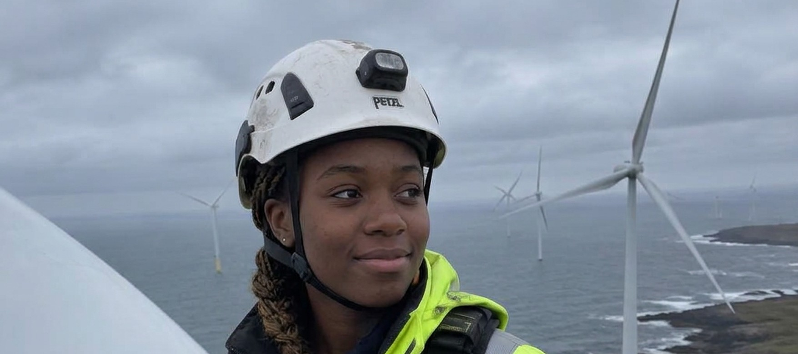
Where science can take you
Lab technician
Vet nurse
Wind turbine technician
Electrician
Healthcare support
Science · 4 / 5
Notes:
Ask: which of these jobs surprised you? Encourage students to look each one up on the National Careers Service website for real pay and entry routes.

Slide 5
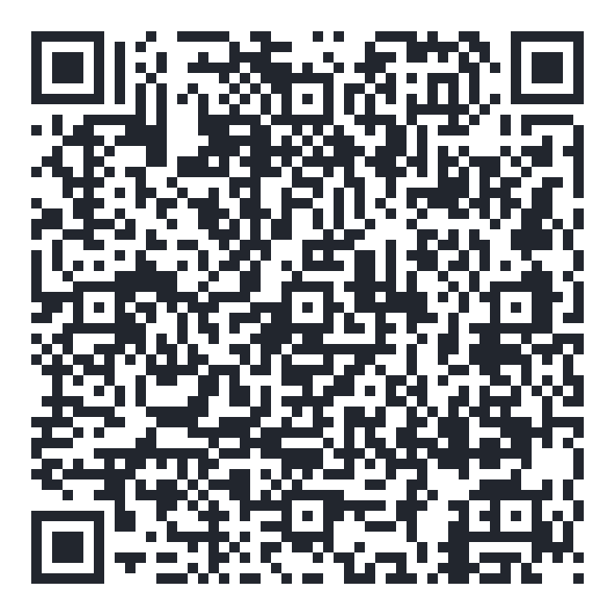
Exit question
Which science topic would you most like to use at work?
Explore your own route — free for 16–24s
shineai.tech/signup
Optional — no one has to sign up
Science · 5 / 5
Notes:
Students write the exit answer on their sheet. Scanning the QR code is optional; never pressure anyone to create an account.

