Slide 1

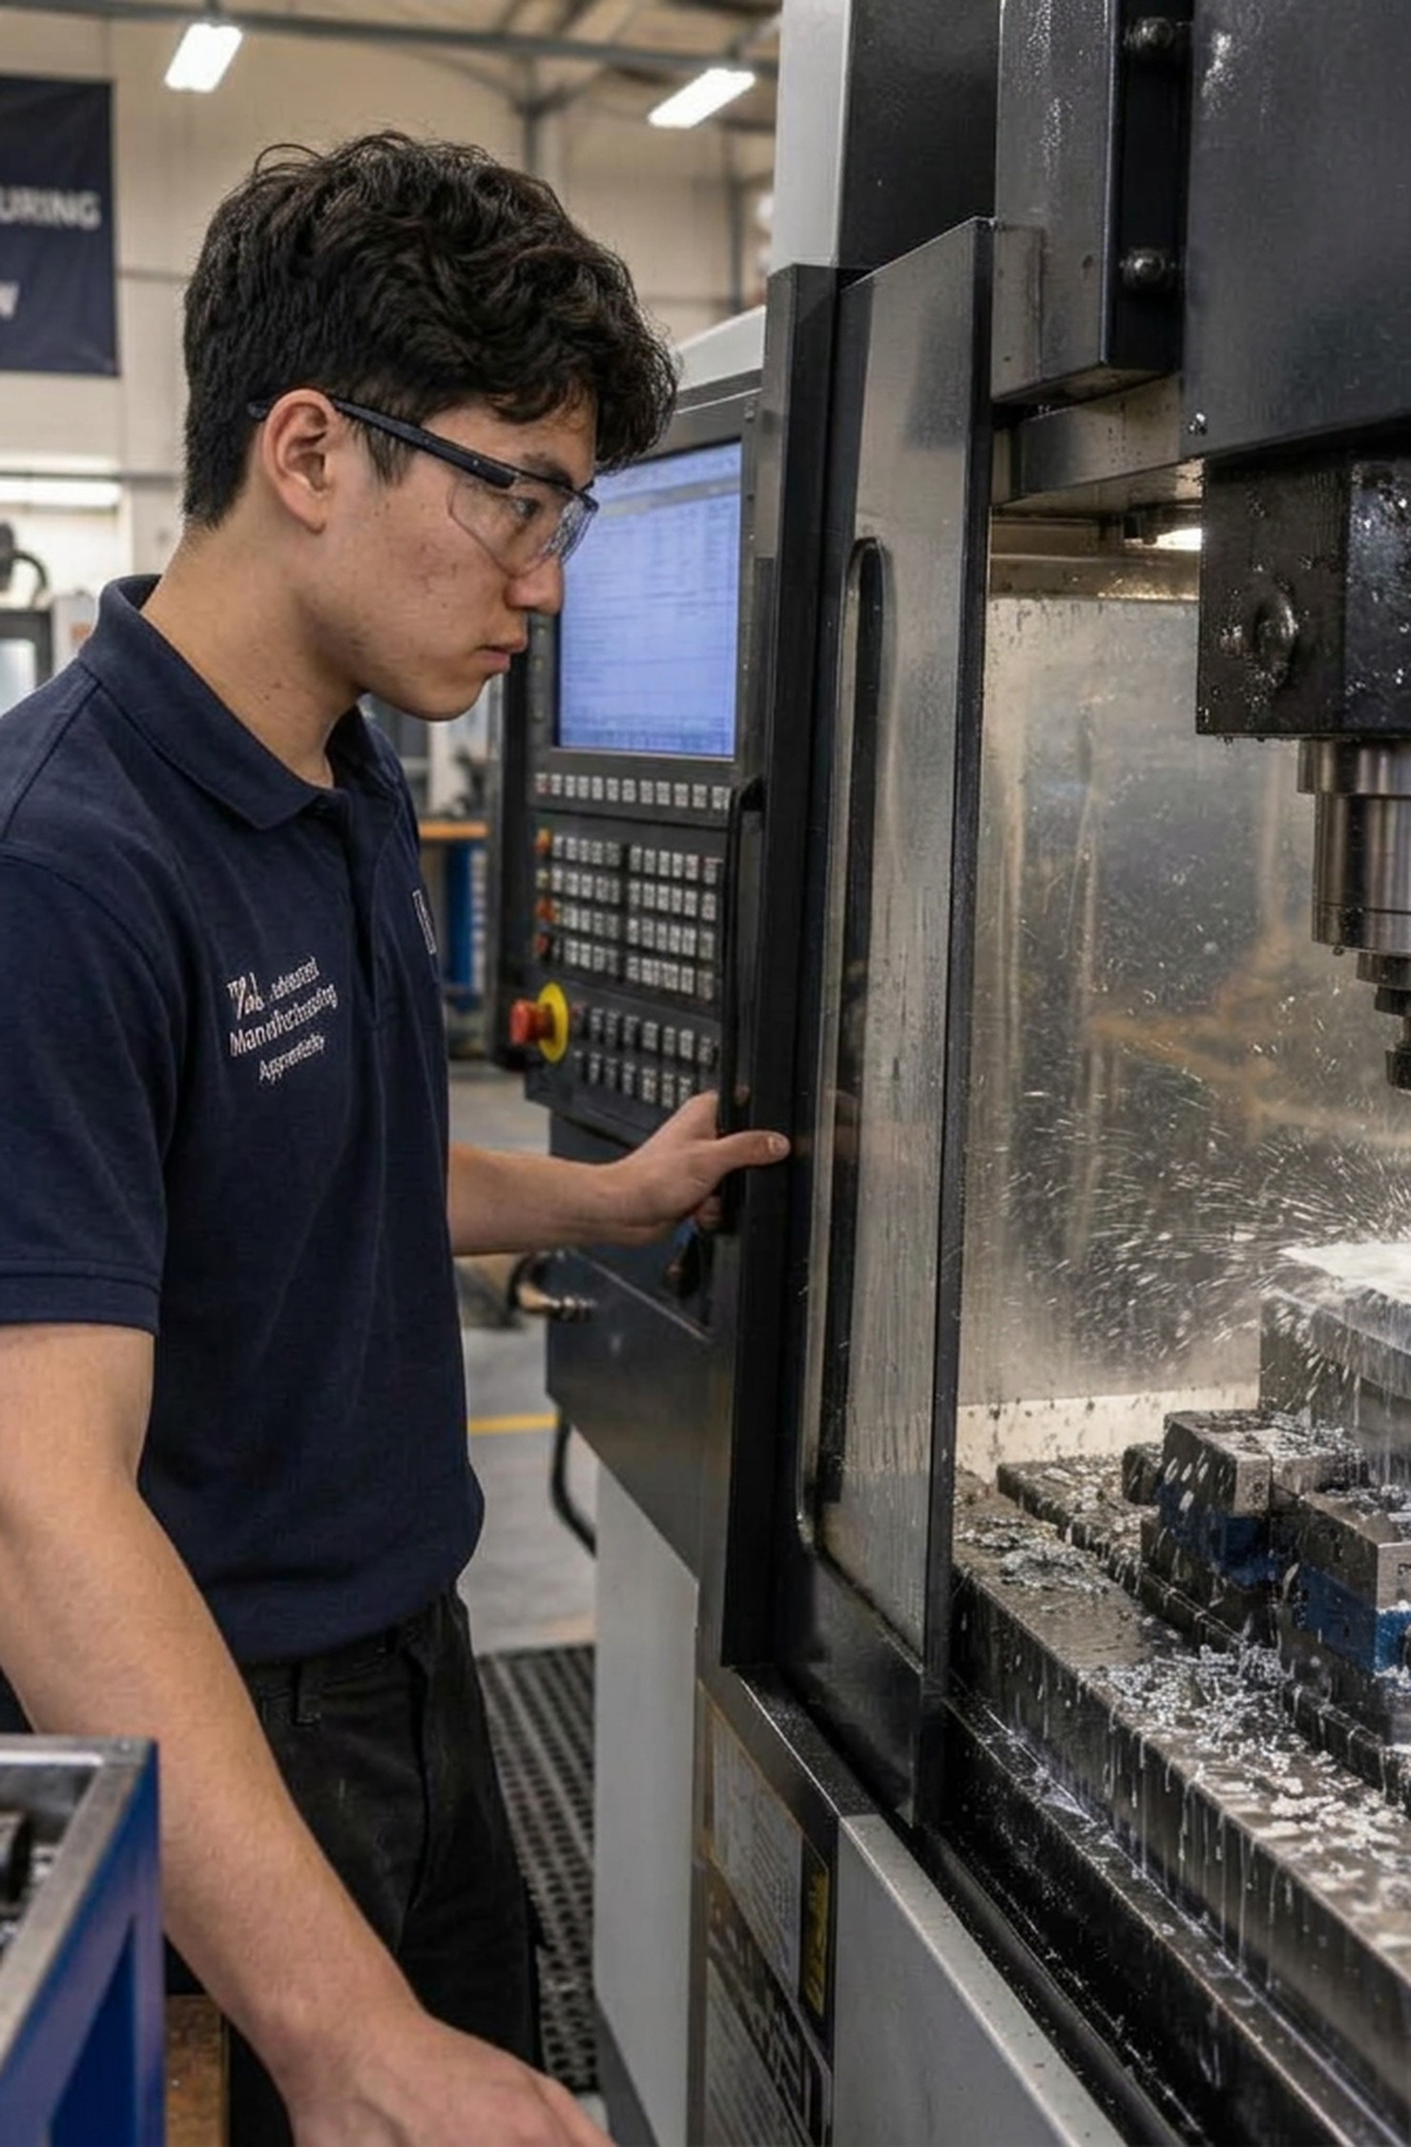

Myth
Maths only matters if you want to be an accountant.
True or false? Decide before we move on.
Maths · 1 / 5
Notes:
Read the myth aloud. Ask students to vote true or false. Don't reveal the answer yet. Time: 25–40 minutes total.

Slide 2

Truth
Your first payslip is maths — and so are most skilled jobs.
UK minimum wage from 1 April 2026:
Under 18 and first-year apprentices: £8.00 an hour
Age 18 to 20: £10.85 an hour
Age 21 and over: £12.71 an hour
Maths · 2 / 5
Notes:
Reveal the truth. Note: these are legal minimums; many employers pay more. Rates usually change each April — check gov.uk/national-minimum-wage-rates.

Slide 3
Pay by age: work it out
1. A Saturday job is 16 hours a week. Find the weekly pay on each rate.
2. Full time is 37.5 hours a week for 52 weeks. Find the yearly pay on each rate.
3. Stretch: how much more a year does a 21-year-old earn than a 17-year-old?
Maths · 3 / 5
Notes:
Students use the student sheet. Answers / guidance: Q1 weekly (16 h): £128.00 / £173.60 / £203.36. Q2 yearly (1,950 h): £15,600.00 / £21,157.50 / £24,784.50 (before tax). Q3: £24,784.50 − £15,600.00 = £9,184.50 more a year. Note: these are legal minimums; many employers pay more. Rates usually change each April — check gov.uk/national-minimum-wage-rates.

Slide 4


Where maths can take you
Electrician
CNC machinist
Site engineer
Nursing
Software developer
Maths · 4 / 5
Notes:
Ask: which of these jobs surprised you? Encourage students to look each one up on the National Careers Service website for real pay and entry routes.

Slide 5

Exit question
Which job on the slide uses the maths you did today?
Explore your own route — free for 16–24s
shineai.tech/signup
Optional — no one has to sign up
Maths · 5 / 5
Notes:
Students write the exit answer on their sheet. Scanning the QR code is optional; never pressure anyone to create an account.

