Slide 1



Myth
There’s one right path after school.
True or false? Decide before we move on.
Form time / PSHE · 1 / 5
Notes:
Read the myth aloud. Ask students to vote true or false. Don't reveal the answer yet. Time: 20–30 minutes total.

Slide 2

Truth
There are loads of good routes — and you can change direction.
Apprenticeships: paid work plus training
T Levels: two-year technical courses with a placement
University, college and training courses
Going straight into work, then building skills
Form time / PSHE · 2 / 5
Notes:
Reveal the truth. Common confusion: T Levels are equivalent to three A Levels and include an industry placement of at least 45 days.

Slide 3
Route finder: three questions
1. Write three things you enjoy doing (in or out of school).
2. Write two things people say you are good at.
3. Pick two routes from the list that could use them — and say why.
Form time / PSHE · 3 / 5
Notes:
Students use the student sheet. Answers / guidance: There are no wrong answers. Encourage students to name a real reason (an interest or strength) for each route. Common confusion: T Levels are equivalent to three A Levels and include an industry placement of at least 45 days.

Slide 4


Where your choices can take you
Apprenticeships
T Levels
University
Training
Work
Form time / PSHE · 4 / 5
Notes:
Ask: which of these jobs surprised you? Encourage students to look each one up on the National Careers Service website for real pay and entry routes.

Slide 5
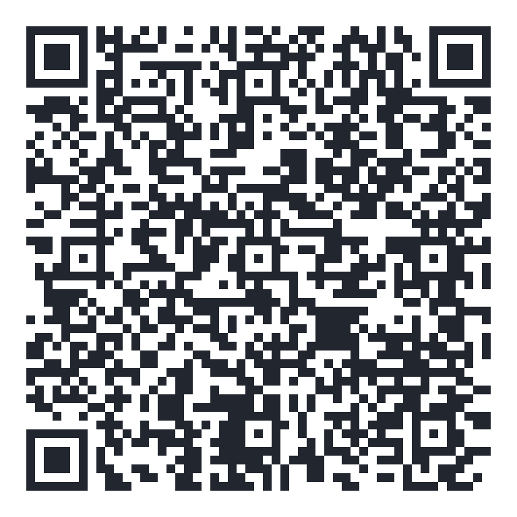
Exit question
Which route had you not thought about before today?
Explore your own route — free for 16–24s
shineai.tech/signup
Optional — no one has to sign up
Form time / PSHE · 5 / 5
Notes:
Students write the exit answer on their sheet. Scanning the QR code is optional; never pressure anyone to create an account.

