Slide 1



Myth
English only matters if you want to be a writer or a teacher.
True or false? Decide before we move on.
English · 1 / 5
Notes:
Read the myth aloud. Ask students to vote true or false. Don't reveal the answer yet. Time: 25–40 minutes total.

Slide 2

Truth
Every application, handover and report is written — clear English gets you hired.
Employers read your CV and application first
Nurses and carers write handover notes
Engineers and technicians write reports
Customer roles depend on clear emails and calls
English · 2 / 5
Notes:
Reveal the truth. Students with no work experience can use school, clubs, caring responsibilities, sport or hobbies.

Slide 3
Show, don’t tell: upgrade a CV line
1. Read the weak line: “I am a hard worker and a team player.”
2. Rewrite it with evidence: what did you do, where, and what happened?
3. Swap with a partner. Underline the strongest verb in their sentence.
English · 3 / 5
Notes:
Students use the student sheet. Answers / guidance: Model answer: “I volunteered at my local food bank every Saturday for six months, sorting donations with a team of five and training two new volunteers.” Look for: a real activity, a time frame, numbers where possible and a strong verb (organised, trained, fixed, led). Students with no work experience can use school, clubs, caring responsibilities, sport or hobbies.

Slide 4


Where English can take you
Marketing
Law
Healthcare
Engineering
Customer service
English · 4 / 5
Notes:
Ask: which of these jobs surprised you? Encourage students to look each one up on the National Careers Service website for real pay and entry routes.

Slide 5
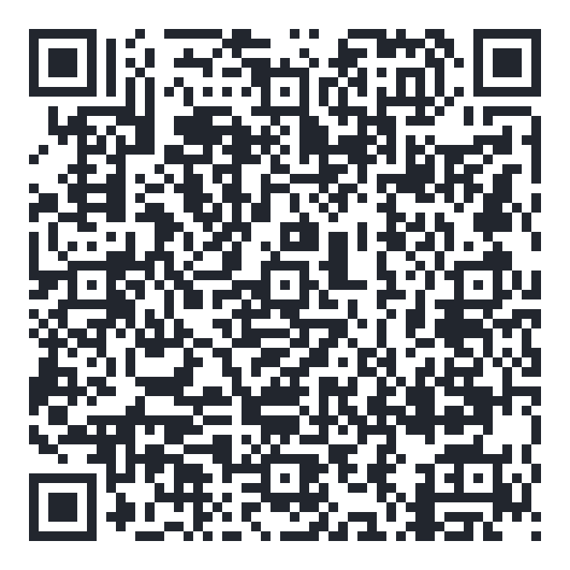
Exit question
What is one thing you have done that proves a skill an employer wants?
Explore your own route — free for 16–24s
shineai.tech/signup
Optional — no one has to sign up
English · 5 / 5
Notes:
Students write the exit answer on their sheet. Scanning the QR code is optional; never pressure anyone to create an account.

