Slide 1



Your future has
more than one route.
Find careers and next steps that fit you.
Free for 16–24 year olds
Notes:
Start with the question: what could your future look like? Shine helps young people explore options across different industries and routes. No one has to decide today.

Slide 2


Not sure what fits?
That’s normal. Start with what you enjoy, what you’re good at and what matters to you.
There’s more than one good next step.
2 / 5
Notes:
Ask for a show of hands if anyone has ever been asked what they want to do. Reassure the room that not knowing yet is normal; curiosity is a good starting point.

Slide 3
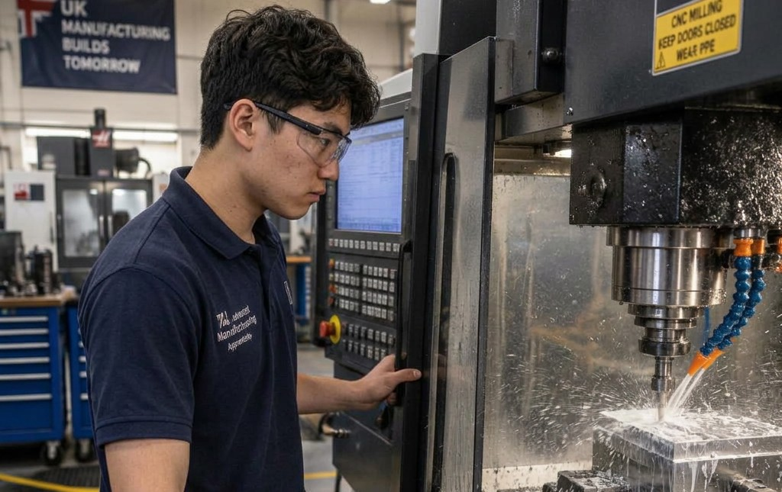


Follow your route
Explore
Discover
Go forward
Start with a 15-minute questionnaire
Careers and routes in industries that are hiring
Build your skills and apply for real roles
3 / 5
Notes:
Describe the journey: a 15-minute questionnaire explores each learner's strengths and interests, Shine suggests careers and routes in in-demand industries that are actually hiring, then learners build a portfolio of skills and apply for real entry-level roles. Signing up is free for 16–24 year olds. The route is a starting point, not a fixed prescription.

Slide 4



The route is yours
to choose.
Apprenticeships
T Levels
University
Training
Work
A personalised, step-by-step plan. Free for 16–24s.
4 / 5
Notes:
There is no single correct route. Depending on interests and eligibility, people might explore apprenticeships, T Levels, university, training or work. Ask which industry image catches their eye.

Slide 5
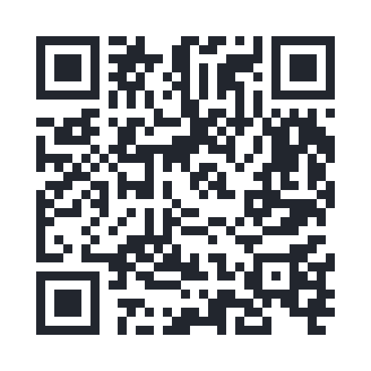
Ready to see
what fits?
Scan to create your free account
shineai.tech/signup
No phone? Type the address into a browser.
Takes about 15 minutes
5 / 5
Notes:
Leave this slide on screen while learners scan. The URL is written out for anyone without a phone. Signing up is free for young people. Do not pressure anyone to create an account.

